Slide 1
建立物理仿真程序基础
韩红雷
中国传媒大学 动画学院

Slide 2
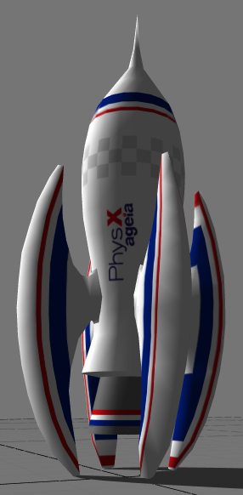
本课主要内容
PhysX物理引擎介绍
如何建立一个简单的PhysX工程
分析PhysX中的各个要素
Notes:
The major competitor to the PhysX SDK is the Havok SDK, which is used in more than 150 games, including major titles like Half-Life 2 and Dead Rising.[2]
To compete with the PhysX PPU, Havok FX will be able to take advantage of multi-GPU technology from ATI/AMD (CrossFire) and NVIDIA (SLI) using existing cards to accelerate certain physics calculations.[3]
Havok's solution divides the physics simulation into effect and gameplay physics, with effect physics being offloaded (if possible) to the GPU as Shader Model 3.0 instructions and gameplay physics being processed on the CPU as normal. The important distinction between the two are that effect physics do not affect gameplay (dust or small debris from an explosion, for example): the vast majority of physics operations are still performed in software. This approach differs significantly from the PhysX SDK, which moves all calculations to the PhysX card if it is present.
NVIDIA's GeForce 8 Series supports a new GPU-based Newtonian physics acceleration technology named Quantum Effects Technology - which will compete directly with the PhysX PPU hardware. NVIDIA provides a SDK Toolkit for what they call CUDA™ (Compute Unified Device Architecture) technology that offers both a low and high-level API to the GPU. Few technical details are available about the physics side of it, and it is not yet clear whether this is part of Havok FX SDK, and/or AGEIA PhysX SDK, or a completely separate engine.[4]
ATI/AMD offers a similar SDK for their ATI-based GPUs and that SDK and technology is called CTM™ (Close to Metal™) which provides a thin hardware interface. AMD has also announced the AMD Stream Processor product line (combining a CPU and a GPU technology on one chip).

Slide 3


PhysX简介
指由AGEIA开发的实时物理引擎中间件SDK
  前身是NovodeX SDK
也指用于加速SDK运算的PPU扩展卡
我们将其统一为Ageia的物理引擎
现在已然在NVIDIA帐下
Notes:
PhysX can refer either to a proprietary realtime physics engine middleware SDK developed by AGEIA (formerly known as the NovodeX SDK) or their PPU expansion card designed to accelerate that SDK.
Middleware physics engines allow game developers to avoid writing their own code to handle the complex physics interactions possible in modern games. Sony has licensed the PhysX SDK for their PlayStation 3 video game console.[1]

Slide 4


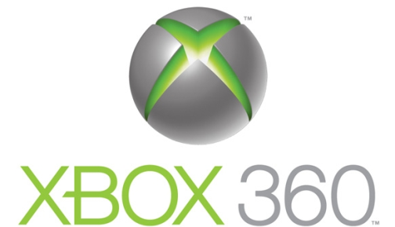
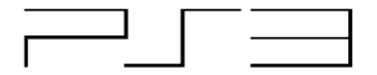
支持平台
支持平台
  PC SW；PPU；PS3；XB360
Notes:
电脑、ps、xbox

Slide 5
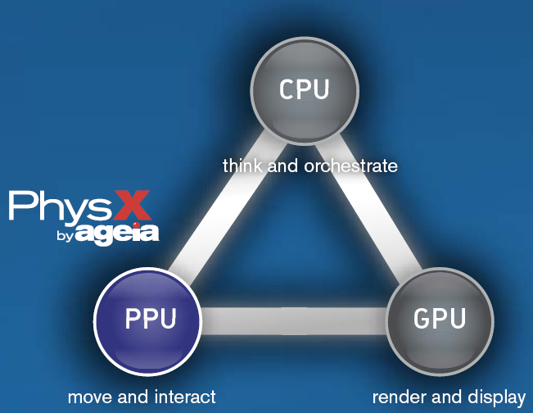
游戏的动力三角

Slide 6
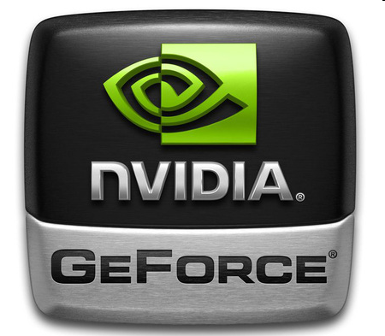
游戏的动力（现在）
Notes:
Nvida有通知游戏硬件的趋势。

Slide 7
获得PhysX SDK
到Ageia注册成为会员
进入http://support.ageia.com/下载SDK
更新最新Nvidia显卡驱动
注册开发者账号
NVIDIA网站PhysX开发者网页下载：
  http://developer.nvidia.com/physx
下载PhysX最新SDK
Notes:
关于PhysX sdk的安装.首先要进入http://support.ageia.com/下载SDK，注意的是Ageia的SDK只对注册用户开放下载。注册是免费的，但好像要经过审核才会开通，不过一般都会通过的

Slide 8
物理知识基础
主要用到以下物理知识：
  参考坐标系
  位置
  速度
  加速度
  动量
  力
  旋转运动
  能量
  摩擦力
  冲量
  碰撞
  约束
Notes:
The AGEIA PhysX SDK unites rigid body dynamics simulation and collision detection in a single easy-to-use package.
The rigid body dynamics component enables you to simulate objects with a high degree of realism. It makes use of physics concepts such as reference frames, position, velocity, acceleration, momentum, forces, rotational motion, energy, friction, impulse, collisions, constraints, and so on in order to give you a construction kit with which you can build many types of mechanical devices.

Slide 9
Library Redistribution
redistribute some of our DLLs to end users
PhysX3Common_*.dll - will always be needed.
PhysX3_*.dll - will always be needed.
PhysX3Cooking_*.dll - you only need to bundle if your application cooks geometry data on the fly.
PhysX3GPU_*.dll - is only needed if your application runs some simulation on the GPU.
PhysX3CharacterKinematic_*.dll- is only needed if your application uses the character controller

Slide 10
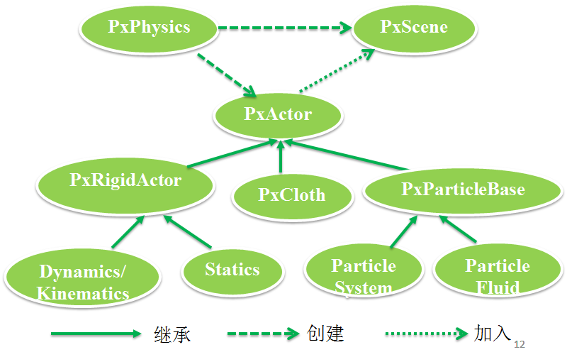


Slide 11
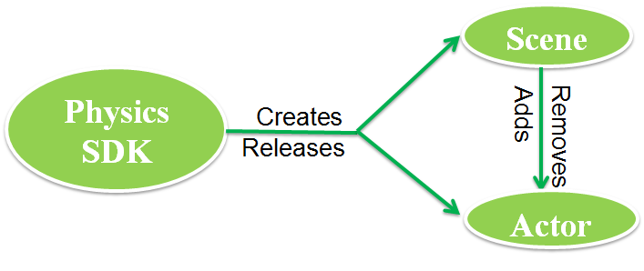

Slide 13
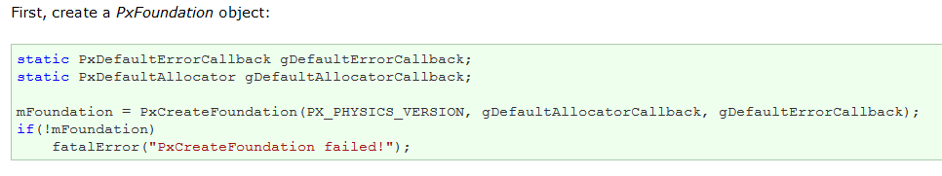
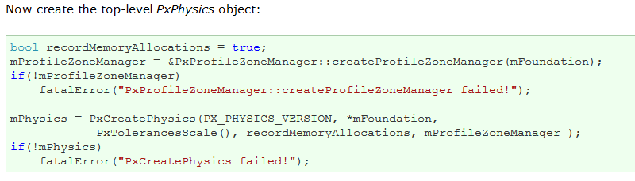
主要步骤

Slide 14
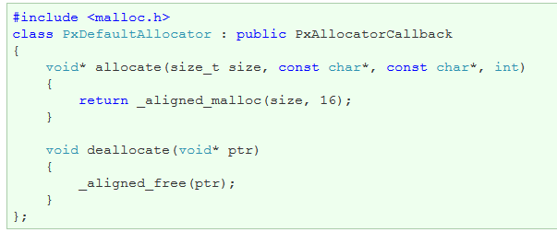
The Allocator Callback
In order to perform dynamic allocation, the SDK requires an implementation of the PxAllocatorCallback interface. PhysX provides default implementations for all supported platforms. Here is the windows version:

Slide 15
Shutting Down
mPhysics->release();
Do not forget to release the foundation object as well, but only after all other PhysX modules have been released:
mFoundation->release();

Slide 16
PhysX组成元素
Scene场景
  就像演员表演都需要一个舞台一样, PhysX的所有物理运动都在这个scene中进行
Actor角色
  在场景中,所有参与运算的实体都是一个角色
body刚体
  用来记录物体之间世界交互的各种系数,如速度,阻尼等
shape形状
  描述和表达某一角色的外形,PhysX中提供4种基本形状，盒子，球，胶囊以及平面

Slide 17
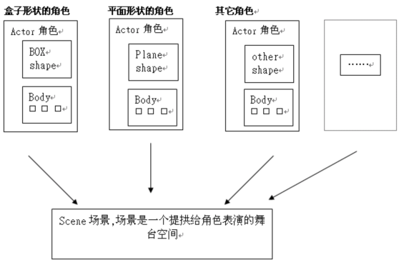
示意图

Slide 18
使用PhysX的基本步骤
创建PhysX SDK，并赋予某些物理量初值
创建Scene，并进行初始化设置
创建地面
创建其他角色（盒子）
让物理仿真开始
更新仿真状态
绘制
重复6～7

Slide 19
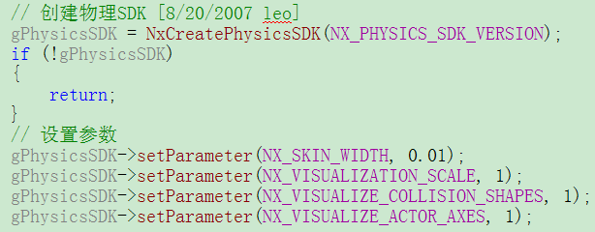
1 创建PhysX SDK

Slide 20
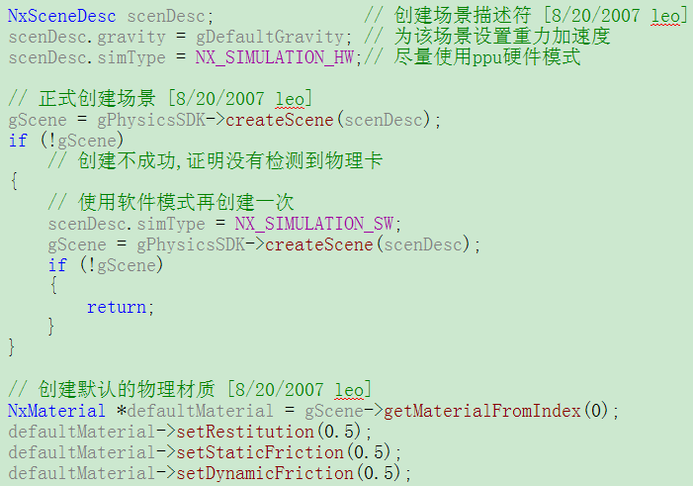
2 创建Scene

Slide 21
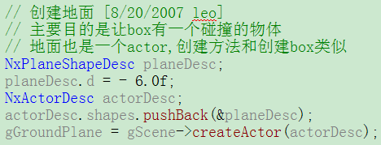
3 创建地面

Slide 22
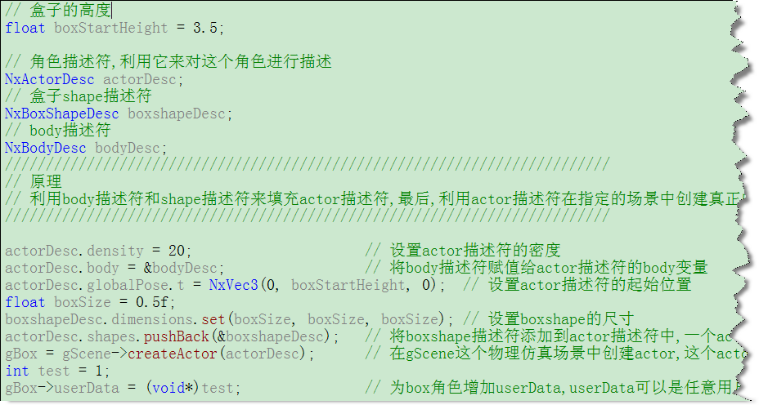
4 创建其他角色

Slide 23
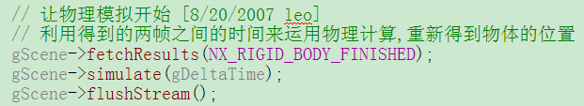
5 让物理仿真开始

Slide 24
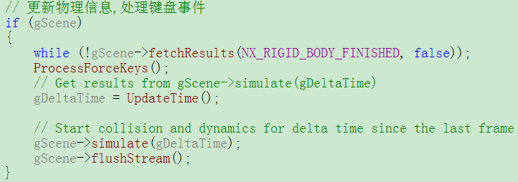
6 更新仿真状态

Slide 25
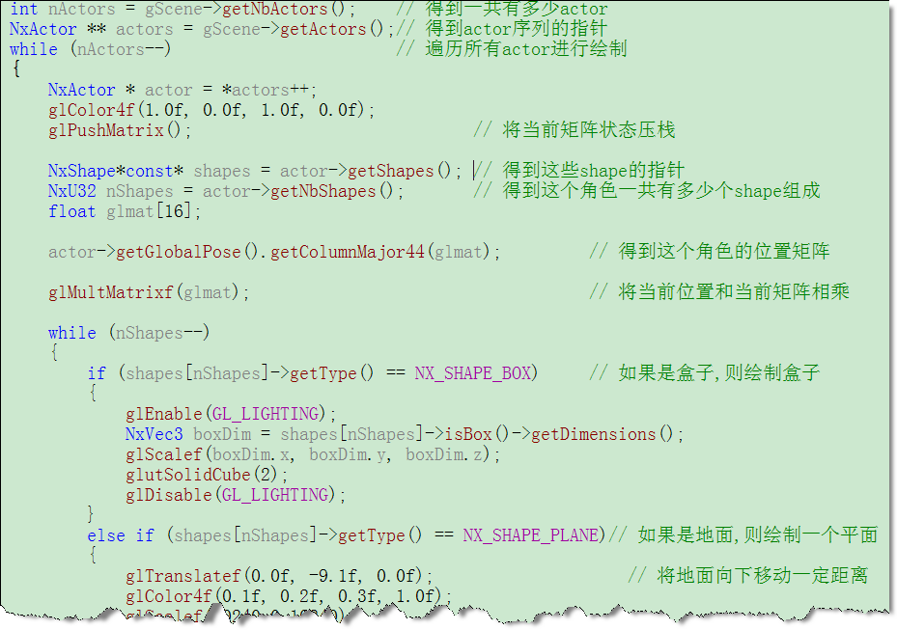
7 绘制

Slide 26
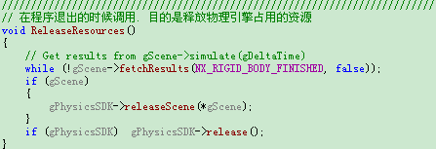
最后释放资源

Slide 27

Shapes in Actors
Actor通常包含shape
  有时候一个，有时候多个，有时候没有
  Shape反映了actor在仿真时候所占据的物理空间
  是碰撞检测的核心
可以创建一个没有shape的actor
  它就像“幽灵”一样不会和其他东西发生碰撞
  但是它仍然受到重力及其他力、力矩的影响
Notes:
Shapes in Actors
Actor通常包含shape——有时候一个，有时候多个，有时候没有。Shape反映了actor在仿真时候所占据的物理空间，是碰撞检测的核心。
可以创建一个没有shapde的actor，它就像“幽灵”一样不会和其他东西发生碰撞，但是它仍然可以和其他actor结合，并且收到重力及其他力、力矩的影响。
然而，没有shape的actor必须具有body，也就是说它不能是静态的。
在创建actor以前，将Shape赋值给它，可以通过将shape描述符插入actor描述符中shapde队列的方式来实现，比如：
NxSphereShapeDesc shapeDesc;
//Set properties of the shape
...
NxActorDesc actorDesc;
//Set properties of the actor
...
actorDesc.shapes.pushback(&shapeDesc);
gScene->createActor(actorDesc);
也可以使用NxActor的方法“createShape”来将shape添加给已经存在的actor上。
NxSphereShapeDesc shapeDesc;
//Set properties of the shape
...
actor->createShape(shapeDesc);
可以使用releaseShape来从actor上删除一个shape，但是对于静态actor不能删除最后一个shape。
当创建actor的时候，以下要求必须满足，这取决于组成actor的shape：
静态actor必须至少有一个shape。
没有立体（solid）shape的actor（换句话说，或者是没有shape或者只有trigger shape），它必须具有body（比如dynamic），并且有特定的质量和惯性张量。
具有立体shape的动力学actor必须至少具有：
非零的质量，零密度并且灭侑惯性张量（惯性张量将基于质量进行计算）
零质量，非零密度和零惯性张量（质量和张量将基于密度计算）
零密度，但有特定的质量和惯性张量
否则actor将不能被创建

Slide 28
设置shape的方式
NxSphereShapeDesc shapeDesc;
//Set properties of the shape
...
NxActorDesc actorDesc;
//Set properties of the actor
...
actorDesc.shapes.pushback(&shapeDesc);
gScene->createActor(actorDesc);
也可以使用NxActor的方法“createShape”来将shape添加给已经存在的actor上。
NxSphereShapeDesc shapeDesc;
//Set properties of the shape
...
actor->createShape(shapeDesc);
Notes:
NxSphereShapeDesc shapeDesc;
//Set properties of the shape
...
NxActorDesc actorDesc;
//Set properties of the actor
...
actorDesc.shapes.pushback(&shapeDesc);
gScene->createActor(actorDesc);
也可以使用NxActor的方法“createShape”来将shape添加给已经存在的actor上。
NxSphereShapeDesc shapeDesc;
//Set properties of the shape
...
actor->createShape(shapeDesc);
可以使用releaseShape来从actor上删除一个shape，但是对于静态actor不能删除最后一个shape。

Slide 29
创建actor时注意
静态actor必须至少有一个shape
没有立体（solid）shape的actor它必须具有body(比如dynamic)，并且有特定的质量和惯性张量
具有立体shape的动力学actor必须至少具有：
  非零的质量，零密度并且没有惯性张量（惯性张量将基于质量进行计算）
  零质量，非零密度和零惯性张量（质量和张量将基于密度计算）
  零密度，但有特定的质量和惯性张量
  否则actor将不能被创建
Notes:
当创建actor的时候，以下要求必须满足，这取决于组成actor的shape：
静态actor必须至少有一个shape。
没有立体（solid）shape的actor（换句话说，或者是没有shape或者只有trigger shape），它必须具有body（比如dynamic），并且有特定的质量和惯性张量。
具有立体shape的动力学actor必须至少具有：
非零的质量，零密度并且没有惯性张量（惯性张量将基于质量进行计算）
零质量，非零密度和零惯性张量（质量和张量将基于密度计算）
零密度，但有特定的质量和惯性张量
否则actor将不能被创建

Slide 30
Shape的种类
Plane Shape
Sphere Shape
Box Shape
Capsule Shape
Heightfield Shape

Slide 31
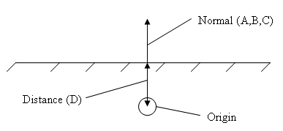
Plane Shape
Plane（NxPlaneShape类）用来模拟小型地面
  ax + by + cz = d
Plane是static，不能赋予可移动的actor
plane的等式永远在世界坐标系中，shape的相对变换将被忽略
Plane表示一个半空间
Notes:
Plane（NxPlaneShape类）用来用在简单demo场合，模拟小型地面。在世界坐标系中通过以下公式来确定一个面：
ax + by + cz = d
Plane是static不能赋予可移动的actor；plane的等式永远在世界坐标系中，shape的相对变换将被忽略。但是可以通过手动改变plane的公式来改变位置。
Plane表示一个半空间而不是无限小的shape。这样，所有在plane后面的点被当作和它碰撞来处理。所以，当一个物体被投掷到plane上面后，它不会穿过plane继续降落。
由于plane被当作static物体来处理，所以它们从来不报告碰撞。
Example
NxPlaneShapeDesc planeDesc;
NxActorDesc actorDesc;
//create a plane at y=1
planeDesc.normal = NxVec3(0.0f,1.0f,0.0f);
planeDesc.d = 1.0f;
actorDesc.shapes.pushBack(&planeDesc);
NxActor *planeActor = gScene->createActor(actorDesc);

Slide 32
Example
NxPlaneShapeDesc planeDesc;
NxActorDesc actorDesc;
//create a plane at y=1
planeDesc.normal = NxVec3(0.0f,1.0f,0.0f);
planeDesc.d = 1.0f;
actorDesc.shapes.pushBack(&planeDesc);
NxActor *planeActor = gScene->createActor(actorDesc);

Slide 33
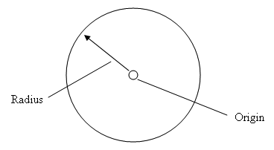
Sphere Shape
Sphere（NxSphereShape类）是最简单的shape
它们唯一的属性是半径

Slide 34
Example
NxBodyDesc bodyDesc;
NxActorDesc actorDesc;
NxSphereShapeDesc sphereDesc;
sphereDesc.radius = 1.0f;
actorDesc.shapes.pushBack(&sphereDesc);
actorDesc.body = &bodyDesc;
actorDesc.density = 10.0f;
actorDesc.globalPose.t = NxVec3(0.0f,0.0f,0.0f); //Position at the origin.
NxActor *actor=gScene->createActor(ActorDesc);

Slide 35
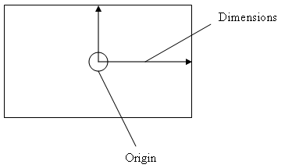
Box Shape
Boxes（NxBoxShape类）有维度属性
原理是立体的宽度一半、高度一半、深度一半

Slide 36
Example
//Create a dynamic actor with a box shape.
NxActorDesc actorDesc;
NxBodyDesc bodyDesc;
NxBoxShapeDesc boxDesc;
boxDesc.dimensions.set(0.5f,0.5f,0.5f);
//The actor has one shape, a 1m cube.
actorDesc.shapes.pushBack(&boxDesc);
actorDesc.body = &bodyDesc;
actorDesc.density = 10;
actorDesc.globalPose.t = NxVec3(0.0f,10.0f,0.0f);
//Set initial position.
NxActor *dynamicActor=gScene->createActor(actorDesc);

Slide 37
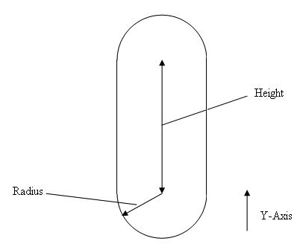
Capsule Shape
Capsule（NxCapsuleShape类），也被叫做line swept sphere，和圆柱形类似，但具有圆形尾部
对于模拟类似人体部位之类的球形时很合适
胶囊形在做碰撞检测的时候十分快速和鲁棒

Slide 38
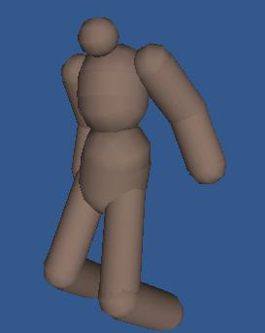
Example
NxActorDesc actorDesc;
NxBodyDesc bodyDesc;
float height = 2.0f;
float radius = 0.5f;
//The actor has one shape, a capsule.
NxCapsuleShapeDesc capsuleDesc;
capsuleDesc.height = height;
capsuleDesc.radius = radius;
actorDesc.shapes.pushBack(&capsuleDesc);
actorDesc.body = &bodyDesc;
actorDesc.density = density;
actorDesc.globalPose.t = NxVec3(0,radius+(NxReal)0.5*height,0);
//Rest the capsule on the y=0 plane.
NxActor *capsuleActor=gScene->createActor(actorDesc);

Slide 39
随堂练习
以示例程序为基础
添加其他物体
  不同的shape
  赋予不同的物理属性
  。。

Slide 40
参考资料
http://en.wikipedia.org/wiki/PhysX（介绍PhysX的WIKI）
《AGEIA PhysX documentation》
《PhysX物理引擎(编程入门)》

